Slide 1
Facilitation Skills
Terri Geerinck
Based on the work of Ingrid Bens
(Facilitation at a Glance)

Slide 2
Today’s plan
This session is designed to develop facilitation skills among college leaders:
Defining facilitation
Core practices
Preparing to facilitate
Meeting management
Supporting participation
Using facilitation tools

Slide 3
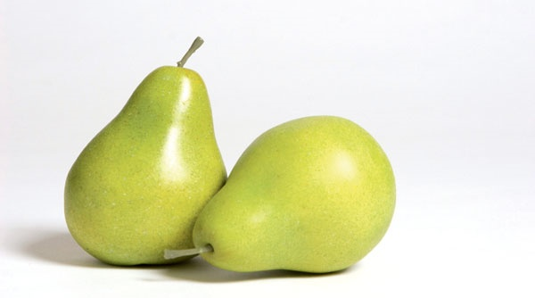
Introduction
On one side of your card, write what you hope to GAIN from this workshop
On the other side, write a list of words that you think characterize facilitator/facilitation
Find the other person who has the same colour dot/triangle on their card as you do, and form a pair
Share what you have written on your cards
Notes:
Once exercise is complete, ask for volunteers to share.
Refer to bottom of page 5 – Facilitators always…stay neutral, listen actively, ask questions, etc.

Slide 4
Goals of facilitation
Facilitators focus on PROCESS (how), not content (what)
Facilitators help groups to achieve THEIR (the group’s) goals
Facilitators help groups to build skills in communication, problem-solving, conflict management, decision making
Facilitators support the development of leadership within the group
Notes:
Refer to top of page 5 – Content (what) and Process (how)
The task…The methods
The subject for discussion…How relations are maintained

Slide 5
Why facilitation skills for leaders?
Leaders who use facilitative techniques and approaches
Are transparent
Show integrity and respect for others
Ensure equal voice and encourage diversity
Encourage innovation through exploration
Are clear about accountability for themselves and their team members
Develop team members’ skills, which supports sustainability and development

Slide 6
Key Facilitation Role
Facilitators remove themselves from their leadership role (if the leader) and use a variety of processes and techniques to support the group /team in achieving its goals
Facilitators use tools/ skills
Pick the ones that match the goals and abilities of group/ team
https://www.youtube.com/watch?v=xQW1fEwYZVA

Slide 7
The facilitator stance
Facilitators do
Help the group define its goals
Suggest processes and tools to assist the group to move toward their goals
Monitor interactions, intervening as appropriate to support continued progress
Provide a “container” and strategies that assist in consensus building and equity of participation
Control the process of the meeting
ASK the group how they want to proceed
Facilitators do NOT
Interject their own opinions
Judge others’ contributions in relation to content
Interrupt when the process is going well
Control the content or decisions of the group work
Monopolize the conversation
Make decisions on content for the group
TELL the group how they should proceed
Notes:
I’m noticing a lot of feeling about…and I’m wondering if we need to change the agenda.
Do check in with the group…

Slide 8
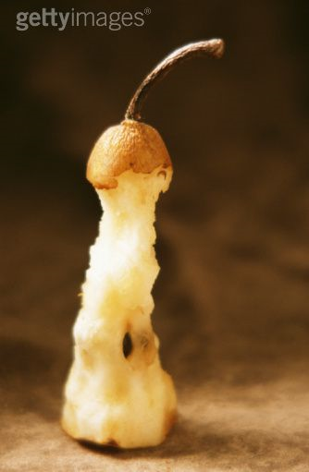
Core Skills Activity
Facilitators have core skills
What are they?
In groups, identify some core skills
Plan to present your work to the group
Notes:
Poster Walk
Provide each pair with a flip chart paper, topic – they write down their findings
Post flip chart around the room
Each pair will post their flipchart with their summary sentence
The entire group will get up and walk around together to each pair’s poster – the pairs will present and allow for discussion
Continue on until we have visit each pair’s poster
Pair 1 – Stay neutral
2- listen actively
3- ask questions
4 - paraphrase to clarify
5 – synthesize ideas
6- stay on track
7 – use spell check button – DRAW SP BUTTON
8- give and receive feedback
9- test assumptions
10- collect ideas
11- summaries clearly

Slide 9
Core Skills
Stay neutral on content
Listen actively
Ask good questions
Paraphrase and Summarize
Keep group on track
Manage Climate
Make process checks
Check Perceptions
Manage Conflict

Slide 10
Time for Check-in
Notes:
Ask participants to raise their hand if they are learning what they hoped to get from the session
Raise hand if they can relate the information to their work

Slide 11
The Process
Stages of Facilitation: Before, During, and After

Slide 12
Before facilitating
Interview event coordinator
Why do they want a facilitator?
Goals/ purpose of event (decision-making or non?)
Potential issues
Empowerment level
Consider checking with event participants (survey or interviews)
Create a draft design; obtain feedback; revise
Have alternate plans, extra process tools in mind
Notes:
Empowerment Level – page 67

Slide 13
During Facilitation: Core Skills
Paraphrasing (mirroring)
Reporting behaviour
Describing feelings
Checking perceptions
Ask, don’t tell!

Slide 14
The Four “Ps” of Facilitation
Process
Progress
Pace
People
Must continually check all four during the session
Decision-making options

Slide 15
At the end of the session
Clarify who is doing what to meet any goals set out during session.
If there is follow-up, plan accordingly with the group, ie, next meeting agenda, when do you check in, etc.
Get feedback from participants.

Slide 16
Meeting management
In your new pair, brainstorm a list of “meeting stoppers”—behaviours that hinder success at meetings
Now brainstorm a list of behaviours that can fix each “stopper”
Let’s stop and share
Notes:
Behaviours that hinder progress of a meeting:
Closed mindedness
Hidden agendas
Environment – room, temp, time of day, etc.
Participants – intimidating
Individual’s frame of mind
Subject knowledge
Cell phones/technology – could be a distraction

Slide 17
Behaviours
Listening to others
Paraphrasing
Praising other’s ideas
Asking for critique
Open to alternatives
Focus on facts
Staying calm and friendly
Interrupting
Not acknowledging
Criticizing
Pushing own ideas
Getting defensive
Sticking to your ideas
Basing ideas on personal agenda
Overly emotional
HELP
HINDER

Slide 18
Barriers to participation
Create a list of things that might prevent people from participating fully in a facilitated event in pairs
Share with larger group
Conflict vs. Debate
Notes:
Feelings and knowledge of topic
History of format
Other participants hinder one’s level of participation
Frustrated with the subject matter/topic/process
The facilitator – Tell, not ask
Unsafe environment – what is said in this rooms stays in this room, etc
How to encourage participation: pg 45
Email agenda prior to event/meeting include learning outcomes
Survey participants
Background of the facilitator
Set norms
Purpose of meeting

Slide 19
Barriers to participation
For full participation, people must
Feel relaxed
Understand the topic
Have had some say in the planning
Feel committed to the topic
Have the required information
Feel safe
Not feel influenced
Have confidence in the facilitator
Are comfortable in the meeting room
Feel the organization will take action on their ideas
How can we ensure these criteria are in place?

Slide 20
Process Tools
Familiar Ones:
SWOT (program review, program development) http://www.researchomatic.com/Swot-Analysis-145181.html
Brainstorming (course development, budget)
Visioning (new program design)
Force-Field Analysis
Gap Analysis (curriculum review, course review)

Slide 21
Force-Field Analysis http://www.change-management-consultant.com/force-field-analysis.html

Slide 22
SWOT ANALYSIS
STRENGTH
WEAKNESS
What do you do well?
What are your asssts?
What could you do better, but don’t?
OPPORTUNITY
THREAT
What current changes may be of benefit?
Are there competitors out there?

Slide 23
Gap Analysis
Current State
GOAL (desired future)
F
THE GAP
Outline Goal Action Plan
FACTORS
The factors keeping us at status quo
What is the gap(s)?
What can we do to achieve our goal?

Slide 24
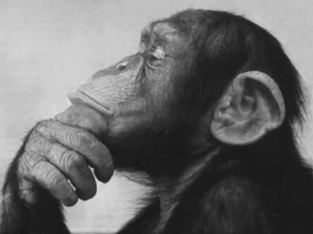
Summary activity
Think-pair-share with your original partner
What is the most valuable thing you learned today?
How do you see yourself using facilitation skills
Faculty?
Program Coordinator?
Associate Dean/ Chair?
Dean?

Slide 25
Recommended resource:
Facilitation at a Glance!:Your Pocket Guide to Facilitation (3rd ed.)
Ingrid Bens, M.Ed.
Contact me: tgeerinck@sympatico.ca

